Slide 1

50.039 Theory and Practice of Deep Learning W4-S3 Introduction to Computer Vision and Convolutional Neural Networks
Matthieu De Mari

Slide 2
About this week (Week 4)
What are images and how is this datatype represented?
What is a pixel and how can its information be interpreted?
What is the spatial dependence property of pixels?
What is the homophily property of pixels?
Why is the linear processing operation failing on images?
What is the convolution operation?
How can we perform image processing using convolutions?
What is padding in convolutions?

Slide 3
About this week (Week 4)
What is stride in convolution?
What is dilation in convolution?
How does convolution apply to higher dimensional images?
How to write our own convolutional processing layer in PyTorch?
What is Conv2d in PyTorch?
What is a Convolutional Neural Network (CNN)?
What is the intuition behind using Convolutional layers in a Convolutional Neural Network?

Slide 4
About this week (Week 4)
How to train our first Convolutional Neural Network on MNIST?
What are other typical image processing layers in Computer Vision and how are they implemented?
What is the pooling layer?
What is the batchnorm layer?
What is the dropout layer?
What is data augmentation in Computer Vision?
What are some milestone Computer Vision models and their contributions to the field of Deep Learning?

Slide 5
About this week (Week 4)
What are the AlexNet and VGG models?
What is a skip connection/residual? What is its effect on a Neural Network and how does it help with vanishing gradient problems?
What are ResNet and DenseNet models?
What is the Inception model?
What is the EfficientNet model?
What is transfer learning and its uses?
How to freeze and fine-tune layers in a Neural Network?

Slide 6
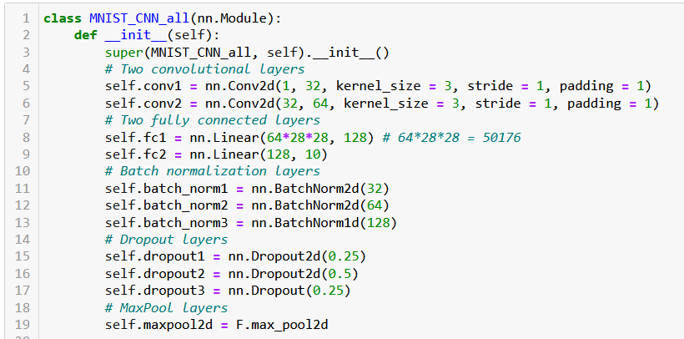
Implementing all layers in our CNN
Let us first define Batchnorm, dropout and maxpool layers in __init__.
Arbitrarily fixing the dropout probabilities (should be hyperparameter?).

Slide 7
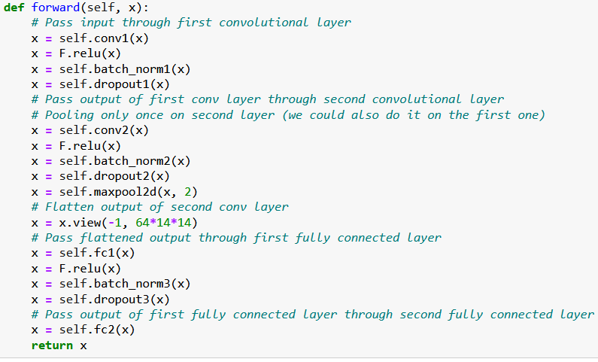
Implementing all layers in our CNN
Using each layer in correct sequence of the forward() method.
Also, one MaxPool layer after last Conv2d.
64*14*14 instead of 64*28*28 in Flatten due to MaxPool

Slide 8
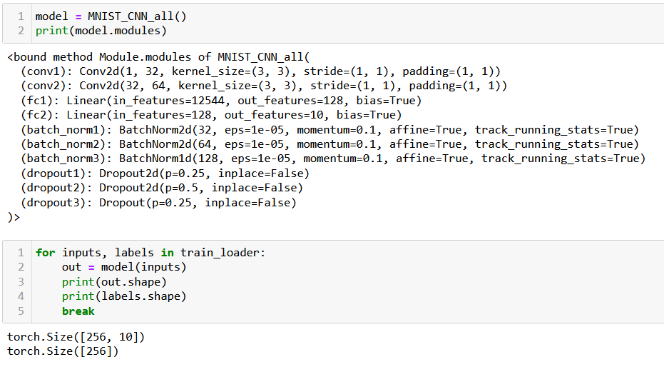
Implementing all layers in our CNN

Slide 9
A final note
The Dropout, Batchnorm and Pooling layers have been introduced in the Computer Vision field.
However, these days, every other field of Deep Learning (e.g. Natural Language Processing) is reusing them in their own models.
Important lesson: you might not necessarily be interested in Computer Vision, but you should still consider learning about it, as many intuitions and tools could be reused in other problems.

Slide 10
A quick word about Data Augmentation
Definition (Data Augmentation):
Data augmentation is a technique used to artificially increase the size of the training dataset by applying various transformations to the existing data.
This helps to expose the model to more variations of the data, making it more robust and less prone to overfitting (according to [Krizhevsky2012]).
More specifically, the model can then learn to recognize patterns and features that are supposed to be invariant to certain changes, such as translations, rotations, and scaling.
Data augmentation can also be used to correct imbalance in the distribution of classes by artificially increasing the number of examples of the under-represented classes (e.g. if you have many pictures of 2s and few 6s), or when the amount of available training data is limited.

Slide 11
Some examples of data augmentation/transform
Some possible ways to perform data augmentation include:
Randomly translating images by a certain number of pixels,
Randomly rotating the images by a small angle,
Randomly scaling the images by a small factor,
Randomly cropping the images,
Randomly flipping the images horizontally/vertically,
Adding random noise to the images,
Randomly changing the brightness or contrast of the images,
Etc.

Slide 12
Some examples of data augmentation/transform
These can be accomplished by using pre-built data augmentation transforms such as RandomRotation, RandomAffine, RandomCrop, RandomHorizontalFlip, RandomGrayscale from the torchvision.transforms library or by using other libraries like imgaug, albumentations, etc.
Feel free to have a look at: https://pytorch.org/vision/stable/transforms.html
Additionally, you can also chain multiple transforms together using the Compose class from the torchvision.transforms library to apply multiple data augmentations at once.

Slide 13
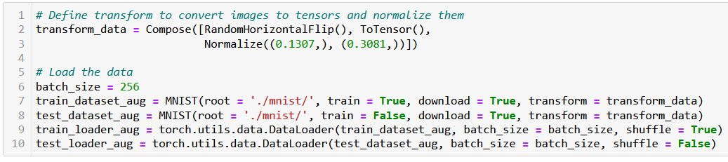
Some examples of data augmentation/transform
For instance, if we want to flip images horizontally, we will simply amend the code below, adding RandomHorizontalFlip() to the list of transforms.
Quick question: Does it makes sense to perform this data augmentation transformation on all pictures? Can all digits be flipped horizontally to generate new valid images?

Slide 14
Studying remarkable CV models
There are several reasons why it is important to learn about milestone computer vision models like AlexNet, Inception, ResNet, etc.
Understanding the history of computer vision and preparing for future advancements: gives appreciation for the progress that has been made in the field and how far it has come.
See how each new model was an improvement upon the previous one and how each model paved the way for new advancements.

Slide 15
Studying remarkable CV models
There are several reasons why it is important to learn about milestone computer vision models like AlexNet, Inception, ResNet, etc.
Understanding the key concepts and techniques: These milestone models introduced key concepts and techniques that are still widely used today, such as convolutional neural networks, residual connections, and transfer learning. By understanding these concepts and techniques, you will have a better understanding of how modern computer vision models work.

Slide 16
Studying remarkable CV models
There are several reasons why it is important to learn about milestone computer vision models like AlexNet, Inception, ResNet, etc.
Improving your skills: Studying these models can help you improve your skills as a practitioner of computer vision. You can learn how to implement these models and use them to solve real-world problems, as well as understand how to adapt and extend these models to fit your own needs (e.g. using a them on a different dataset than the one they were initially trained on).

Slide 17
Studying remarkable CV models
Overall, learning about milestone computer vision models is an important part of advancing your knowledge and skills in the field of computer vision.
We will now discuss, very briefly, some of these important milestone problems.
We strongly advise to pick the Term 7 Computer Vision course, to continue your learning!

Slide 18
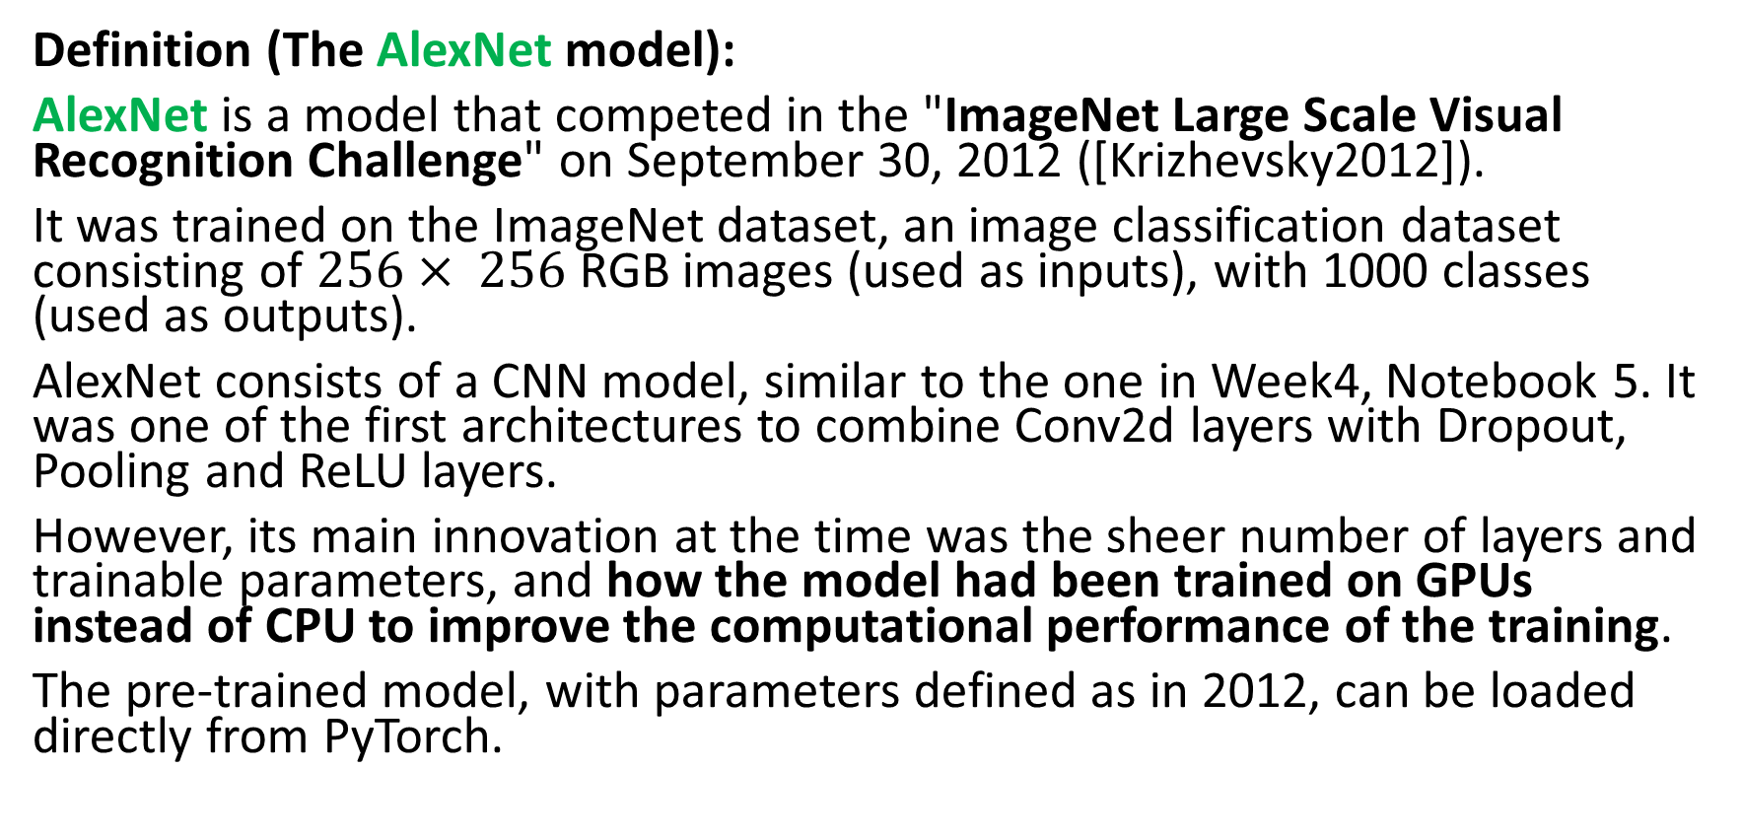
The AlexNet model
Definition (The AlexNet model):
AlexNet is a model that competed in the "ImageNet Large Scale Visual Recognition Challenge" on September 30, 2012 ([Krizhevsky2012]).
It was trained on the ImageNet dataset, an image classification dataset consisting of $256× 256$RGB images (used as inputs), with 1000 classes (used as outputs).
AlexNet consists of a CNN model, similar to the one in Week4, Notebook 5. It was one of the first architectures to combine Conv2d layers with Dropout, Pooling and ReLU layers.
However, its main innovation at the time was the sheer number of layers and trainable parameters, and how the model had been trained on GPUs instead of CPU to improve the computational performance of the training.
The pre-trained model, with parameters defined as in 2012, can be loaded directly from PyTorch.

Slide 19
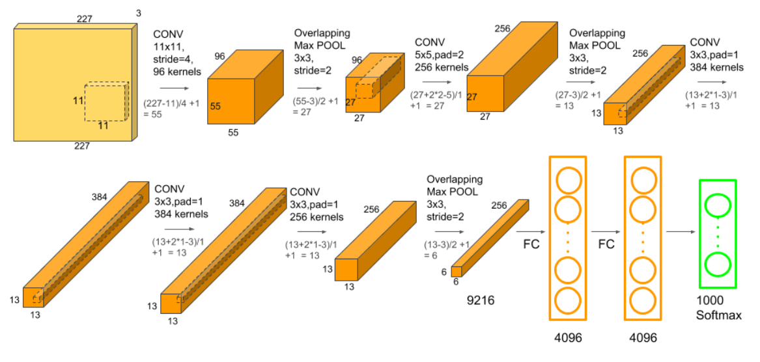
The AlexNet model

Slide 20
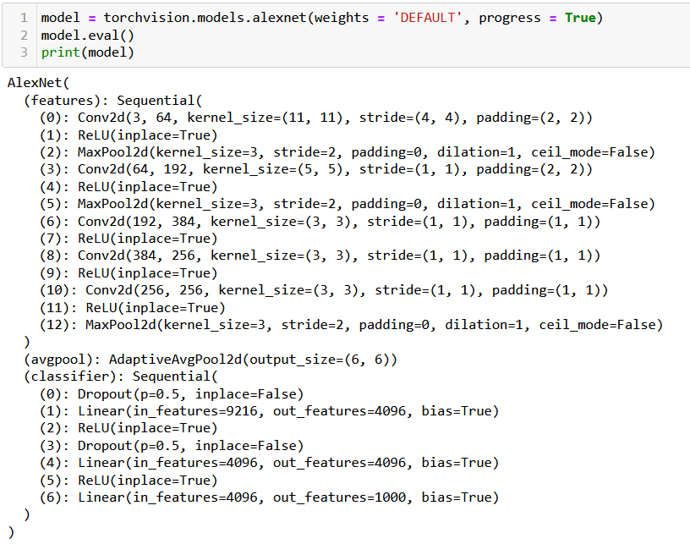

Slide 21
The VGG model
Definition (the VGG model):
VGG was based off of AlexNet, but it has several differences that separated it from other models ([Simonyan2014]):
Instead of using 11x11 kernels with a stride of 4, VGG uses smaller 3x3 kernels with a stride of 1. It also uses three ReLU units instead of just one. For this reason, the decision function is more discriminative, and it has fewer parameters (27 times the number of channels, instead of AlexNet’s 49 times the number of channels).
VGG also incorporates 1x1 convolutional layers to make the decision function more non-linear without changing the receptive fields.
Having less parameters allows to have a larger number of layers, leading to improved performance.

Slide 22
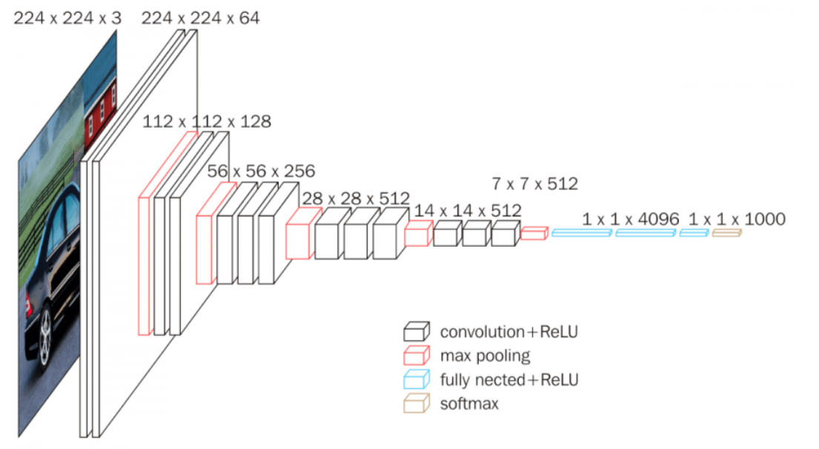
The VGG model

Slide 23
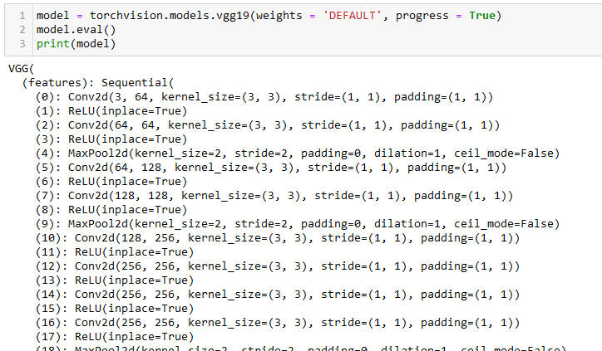

Slide 24
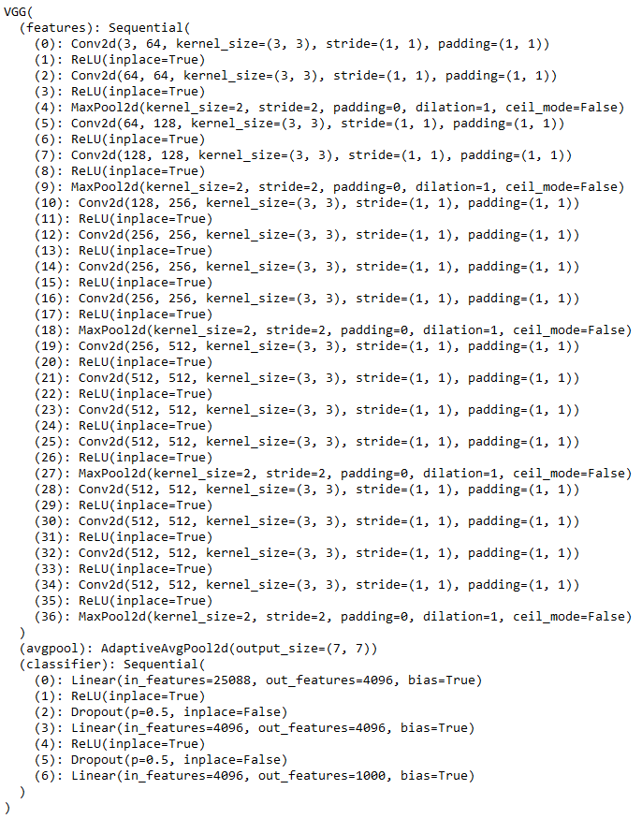

Slide 25
The problem with very deep models
Very deep models, however, start to exhibit a problem…
Training the parameters on the first layers appears to be difficult…
For some reason, the gradients for the parameters of the first layer are close to zero (that is another instance of a vanishing gradient).

Slide 26
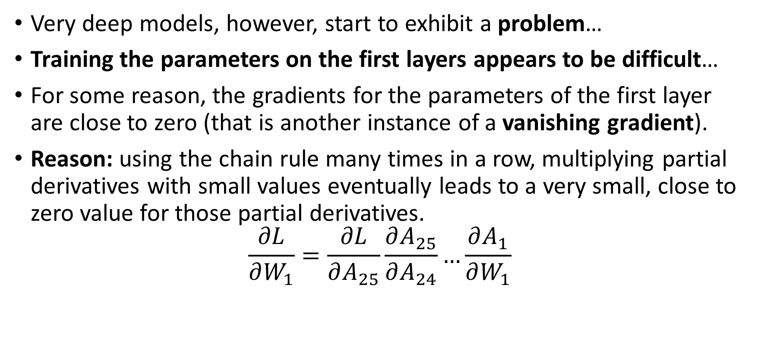
The problem with very deep models
Very deep models, however, start to exhibit a problem…
Training the parameters on the first layers appears to be difficult…
For some reason, the gradients for the parameters of the first layer are close to zero (that is another instance of a vanishing gradient).
Reason: using the chain rule many times in a row, multiplying partial derivatives with small values eventually leads to a very small, close to zero value for those partial derivatives.
$$\frac{∂L}{∂W_{1}}=\frac{∂L}{∂A_{25}}\frac{∂A_{25}}{∂A_{24}}…\frac{∂A_{1}}{∂W_{1}}$$
If all have values in [-1,1]

Slide 27
The problem with very deep models
Very deep models, however, start to exhibit a problem…
Training the parameters on the first layers appears to be difficult…
For some reason, the gradients for the parameters of the first layer are close to zero (that is another instance of a vanishing gradient).
Reason: using the chain rule many times in a row, multiplying partial derivatives with small values eventually leads to a very small, close to zero value for those partial derivatives.
$$\frac{∂L}{∂W_{1}}=\frac{∂L}{∂A_{25}}\frac{∂A_{25}}{∂A_{24}}…\frac{∂A_{1}}{∂W_{1}}$$
Then, multiplication of all these values gives something close to 0
If all have values in [-1,1]

Slide 28
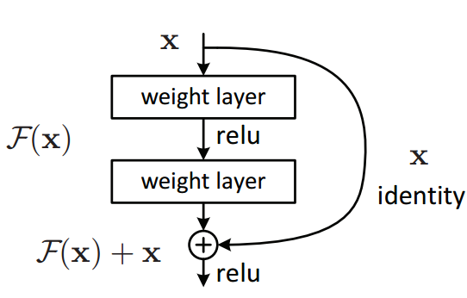
Skip connections
Definition (skip connections):
Skip connections (or shortcut connections) refer to the direct connections between non-adjacent layers in a neural network architecture, bypassing one or more intermediate layers.
The purpose is to allow information to flow rapidly from the input of the network to its output, without being transformed or lost in the intermediate layers.

Slide 29
Skip connections
First, it enables the network to retain information from the input layer, which can be particularly useful in the case of deep neural networks, where the information can get transformed multiple times, hence losing its original information, as it passes through the hidden layers.
Second, skip connections are also mechanisms that facilitate information flow across many layers and help to mitigate the degradation/vanishing gradient problem that appears on large models with many layers and that we have discussed earlier.
Skip connections allow information to flow rapidly from the input to the output, without being transformed or lost in the intermediate layers.

Slide 30
The ResNet model
Definition (the ResNet model):
Skip connections effectively simplifies the network, helping the information flow in the network.
This speeds learning by reducing the impact of vanishing gradients.
The network also gradually restores the skipped layers as it learns the feature space, reusing previous inputs in deeper layers.
Eventually, this allows to train VERY large models, called Residual Networks or ResNets: Milesone ResNets can have up to 152 layers (!), compared to the previous VGG models, which only had up to 19 layers.
ResNet (introduced in [He2015]) has become the most cited neural network of the 21st century.

Slide 31
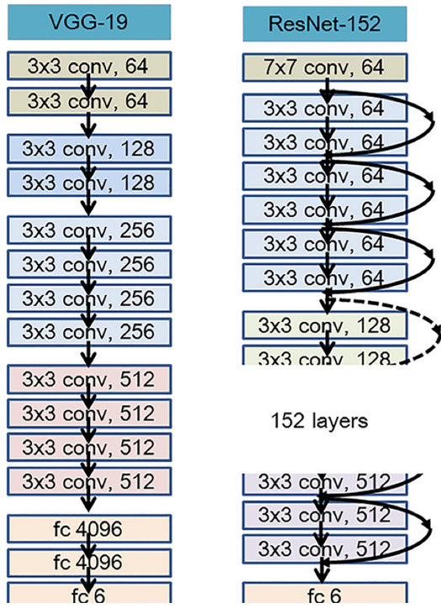

Slide 32
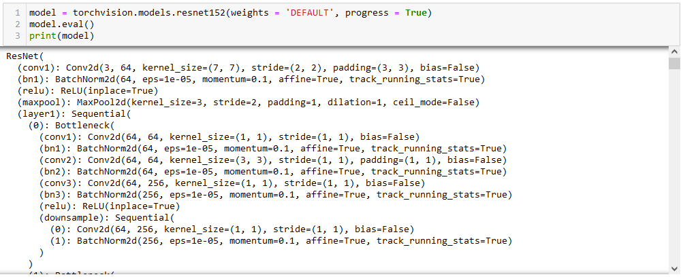
The ResNet model

Slide 33
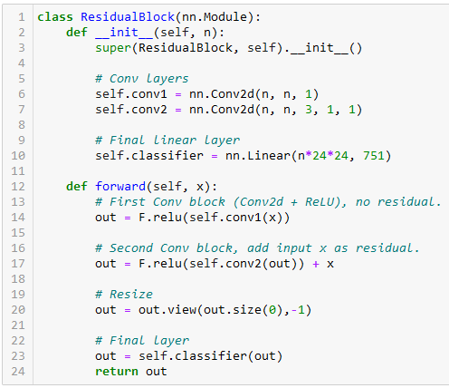
Implementing a skip connection/residual
A residual is simply implemented in the forward method of a Residual block.
Pay attention to the line below, and notice how we add the input x to the output of the second Conv block (but not the first one).
out = F.relu(self.conv2(out)) + x

Slide 34
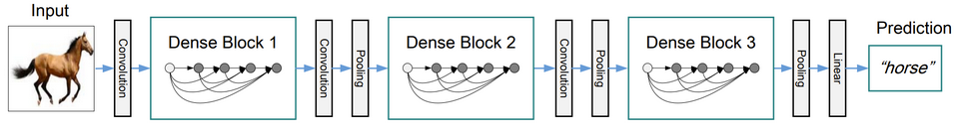
The DenseNet model
Definition (the DenseNet model):
A DenseNet is a type of ResNet that utilises dense connections between layers, through DenseBlocks, where all layers (with matching feature-map sizes) are connected directly with each other, as in ResNet.
In Layman terms, a DenseNet is a Resnet, where all possible skip connections have been drawn in every ResidualBlock, boosting the benefits of ResNets even more ([Huang2016]).

Slide 35
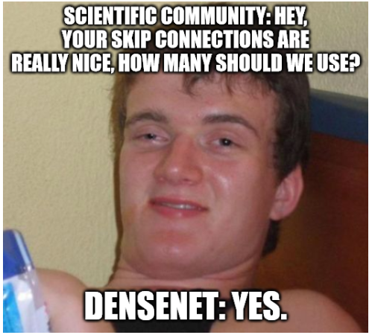
The DenseNet model
Definition (the DenseNet model):
A DenseNet is a type of ResNet that utilises dense connections between layers, through DenseBlocks, where all layers (with matching feature-map sizes) are connected directly with each other, as in ResNet.
In Layman terms, a DenseNet is a Resnet, where all possible skip connections have been drawn in every ResidualBlock, boosting the benefits of ResNets even more ([Huang2016]).

Slide 36
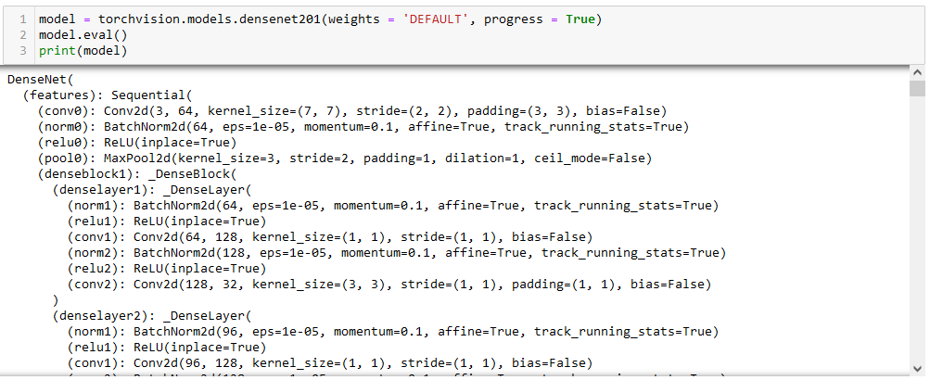
The DenseNet model
Best part? It works, you can use this to train even bigger models…! For instance, DenseNet, below, has 201 (!) layers.

Slide 37
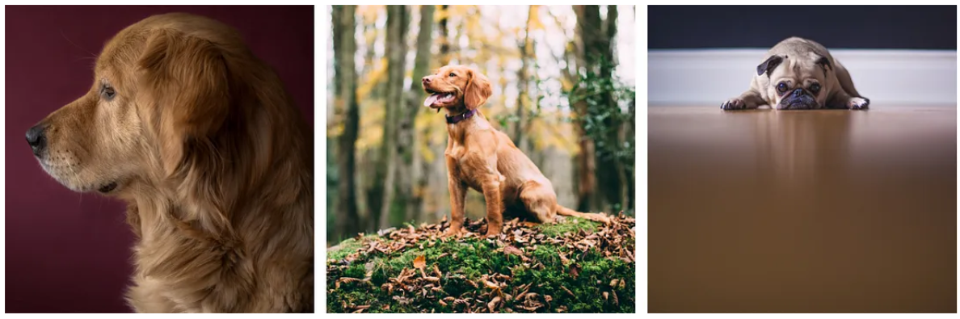
Starting with a problem
Inception models were created to address the following problem: salient parts in the image sometimes have large variations in size.
For instance, an image with a dog can be either of the ones shown below. The area occupied by the dog is different in each image, which might make learning difficult for networks.

Slide 38
The reason for Inception models
Because of this, choosing the right kernel size for the convolution operation becomes tough:
A larger kernel is preferred for information that is distributed more globally (e.g. a zoomed-in picture),
and a smaller kernel is preferred for information that is distributed more locally (e.g. a zoomed-out picture).
Proposed solution: to address this problem, Inception proposes to use multiple Convolution filters, with different sizes, in parallel.

Slide 39
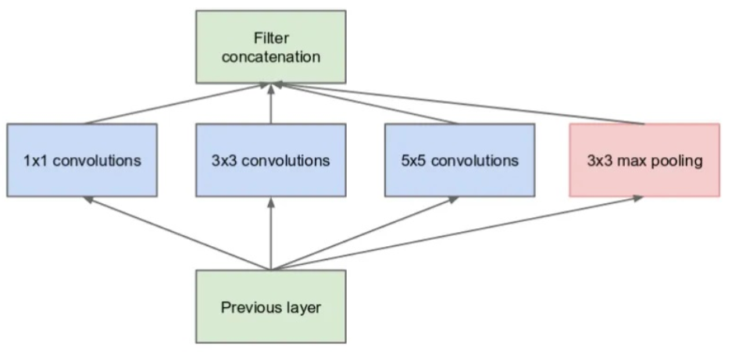
The Inception model
Definition (the Inception block):
Introduced in [Szegedy2014], the Inception model proposes to use multiple Convolution filters, with different sizes, in parallel.
Having different kernel sizes in parallel allows to process images with different salient sizes with the same network.
A typical Inception block is shown on the right.

Slide 40
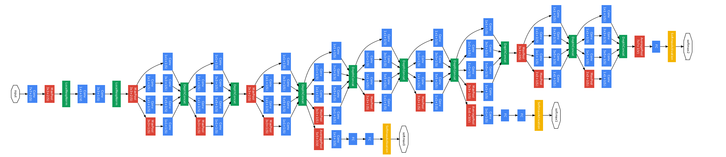
The Inception model
Definition (the Inception model):
The Inception model then assembles multiple Inception blocks, in sequence, also reusing the Pooling, BatchNorm, Dropout and Skip Connection concepts from the previous models.

Slide 41
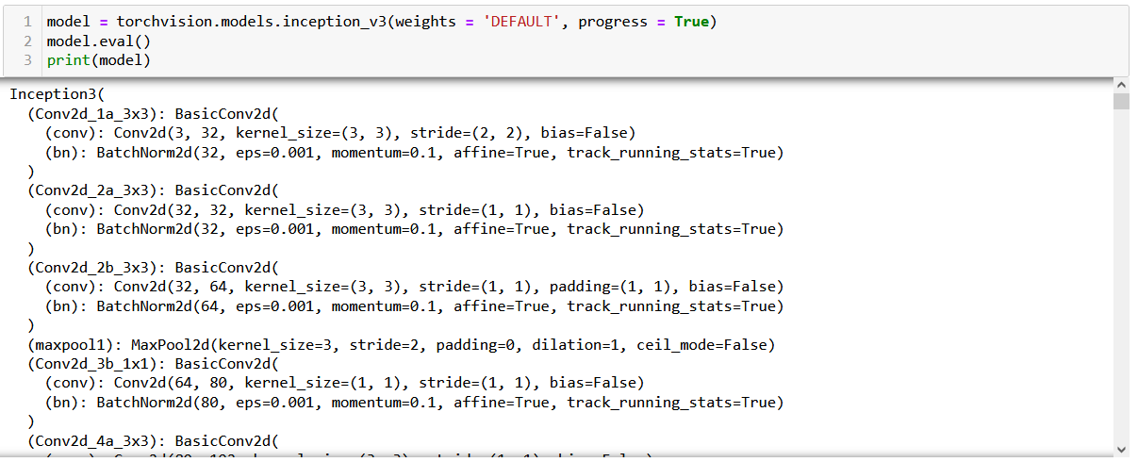
The Inception model
Several version of Inception models were released, with various number of layers and operations.

Slide 42
The EfficientNet model
EfficientNet followed up on the salient problem by proposing a scaling method that uniformly scales all dimensions of depth, width and resolution using a compound coefficient.
The compound scaling method is justified by the intuition that if the input image is bigger, then the network needs more layers to increase the receptive field and more channels are needed to capture more fine-grained patterns on the bigger image.
Different sizes for the pre-trained model were released, ranging from b0 (smaller) to b7 (larger).

Slide 43
The EfficientNet model
Definition (The EfficientNet model):
Introduced in [Tan2019], the EfficientNet model proposed a compound scaling method to adjust the size of the layers and the number of trainable parameters of the Neural Network, dynamically.
This is justified by the intuition that if the input image is bigger, then the network needs more layers to increase the receptive field and more channels to capture more fine-grained patterns on the bigger image.
The implementation of this dynamic scaling is out-of-scope.

Slide 44
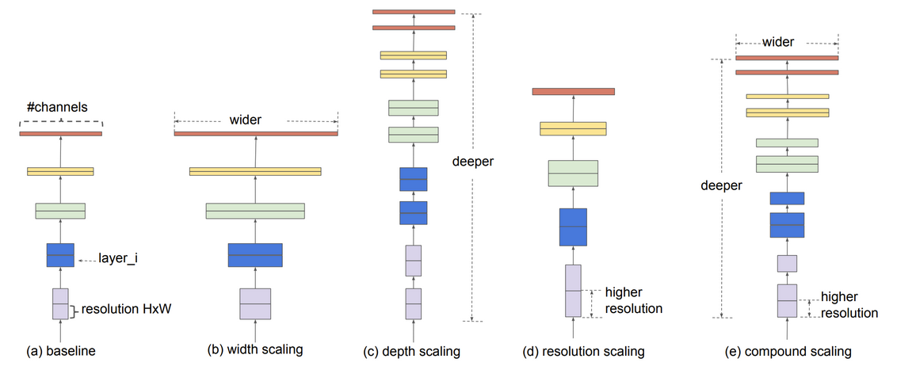
The EfficientNet model

Slide 45
More on Computer Vision
The previous milestone models have a very large number of layers and parameters: training them from scratch on a laptop is a bad idea.
Instead, we gladly rely on the pre-trained versions of these models that have been released by their creators, on GitHub repositories, and sometimes added to PyTorch.
In fact, there are many more models that have marked the history of computer vision, but we have only covered the most famous ones.
These days, however, these models are no longer considered best performance state-of-the-art. Some of these models, e.g. Inception, have even gone through many variations (Inception v1 was released in 2014, Inception v4 in 2016).

Slide 46
More on Computer Vision
If you are curious about the different versions of these milestone models and their more recent implementations, we invite the reader to have a look at the following list/github repo.
https://github.com/gmalivenko/awesome-computer-vision-models
We will NOT discuss the practical implementation of previous models, and gladly leave it to the Term 7 Computer Vision course at SUTD!
Strongly advise you to continue your training on Term 7!
https://istd.sutd.edu.sg/undergraduate/courses/50035-computer-vision

Slide 47
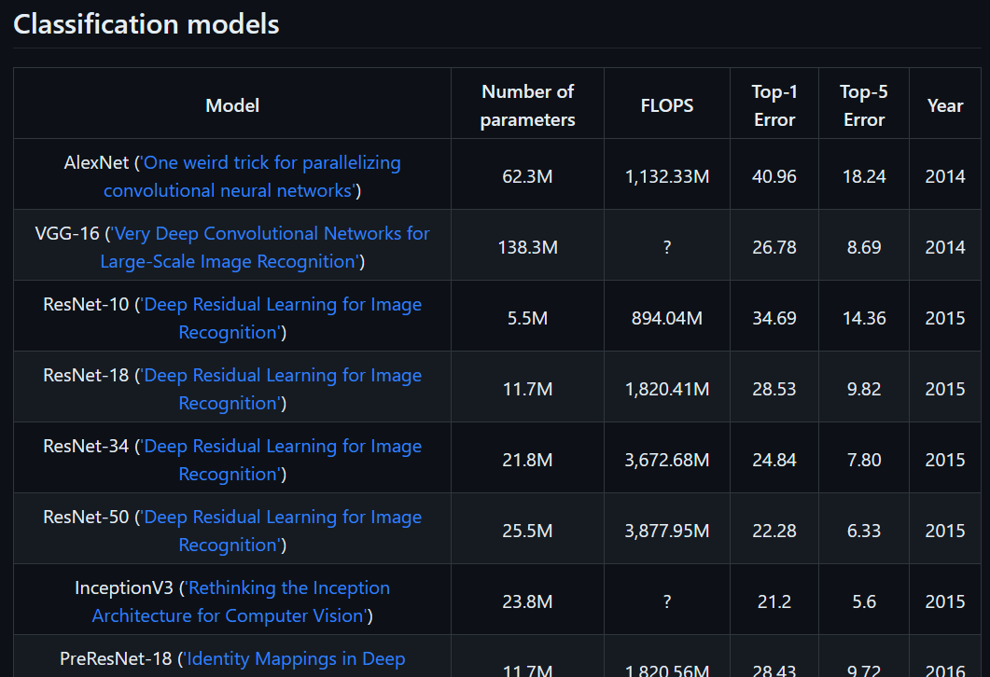
More on Computer Vision
If you are curious about the different versions of these milestone models and their more recent implementations, we invite the reader to have a look at the following list/github repo.
https://github.com/gmalivenko/awesome-computer-vision-models
We will NOT discuss the practical implementation of previous models, and gladly leave it to the Term 7 Computer Vision course at SUTD!
Strongly advise you to continue your training on Term 7!
https://istd.sutd.edu.sg/undergraduate/courses/50035-computer-vision

Slide 48
Transfer Learning
Definition (Transfer Learning):
Many milestone models discussed earlier have been trained for long periods of time. Most of the time, their training cannot be easily replicated, from scratch, without a super-calculator.
Transfer learning suggests to download and reuse the trained versions of said models: with “minor adjustments”, they can potentially be reused on any dataset, even ones that are not even close to the original dataset they were trained on.
For instance, ResNet models were trained on the ImageNet dataset, but with minor adjustments, we could use them on the MNIST dataset.

Slide 49
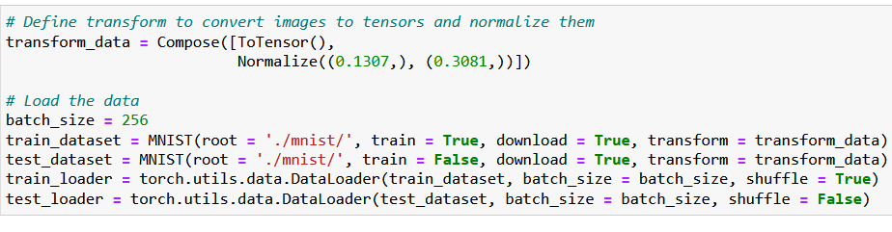
Transfer Learning of ResNet to MNIST
Let us
Prepare the MNIST dataset,

Slide 50
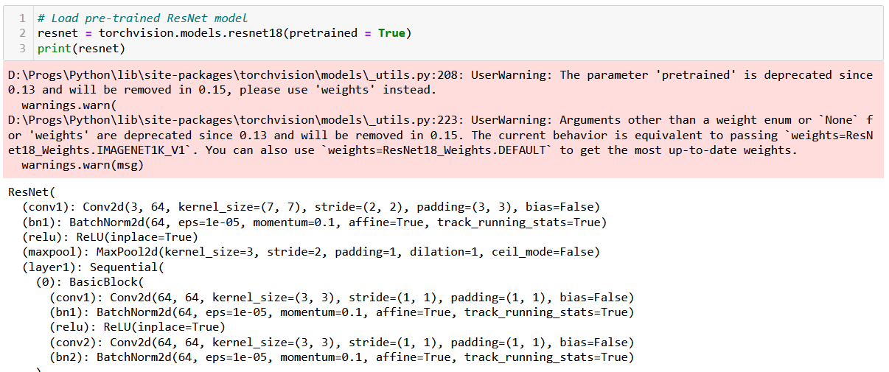
Transfer Learning of ResNet to MNIST
Let us
Prepare the MNIST dataset,
Download the pre-trained version of a ResNet,

Slide 51
Transfer Learning of ResNet to MNIST
Let us
Prepare the MNIST dataset,
Download the pre-trained version of a ResNet,
Replace initial layer so network uses MNIST images,
ImageNet is a RGB dataset, but MNIST is a greyscale one.
We simply remove the initial layer and replace it with an untrained layer that takes images with 1 channel instead of 3 and produces 64 channels just like before.

Slide 52
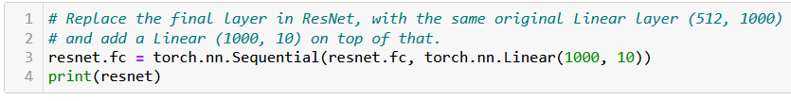
Transfer Learning of ResNet to MNIST
Let us
Prepare the MNIST dataset,
Download the pre-trained version of a ResNet,
Replace initial layer so network uses MNIST images,
Replace final layer to match number of MNIST classes,
ImageNet had 1000 different classes, but MNIST only has 10.
We then add an extra Linear layer, which will reduce the size of the output vector from a 1D vector with 1000 elements to a 1D vector with only 10 elements.

Slide 53
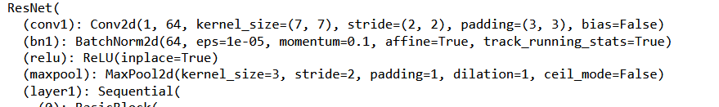
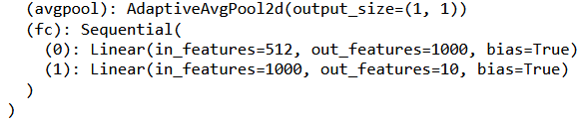
Transfer Learning of ResNet to MNIST
Our new model can now take greyscale images,
And it will output a 1D vector of 10 probabilities,
And – in the middle – all the layers will remain the same and will reuse most trained layers/parameters from the original ResNet model!

Slide 54
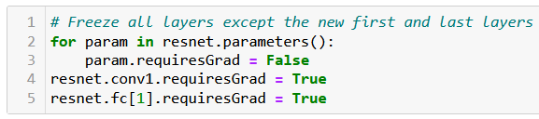
Transfer Learning of ResNet to MNIST
Let us
Prepare the MNIST dataset,
Download the pre-trained version of a ResNet,
Replace initial layer so network uses MNIST images,
Replace final layer to match number of MNIST classes,
Freeze all layers except the new ones!
Freezing prevents parameters from being changed during training.
Let us only train the new layers (very few parameters then, so should not take too long to train these layers only!).

Slide 55
Transfer Learning of ResNet to MNIST
Let us
Prepare the MNIST dataset,
Download the pre-trained version of a ResNet,
Replace the initial layer so network uses MNIST images,
Replace final layer to match number of MNIST classes,
Freeze all layers except the new ones!
And finally, train these new layers that currently have random values in their trainable parameters, using the MNIST dataset!

Slide 56
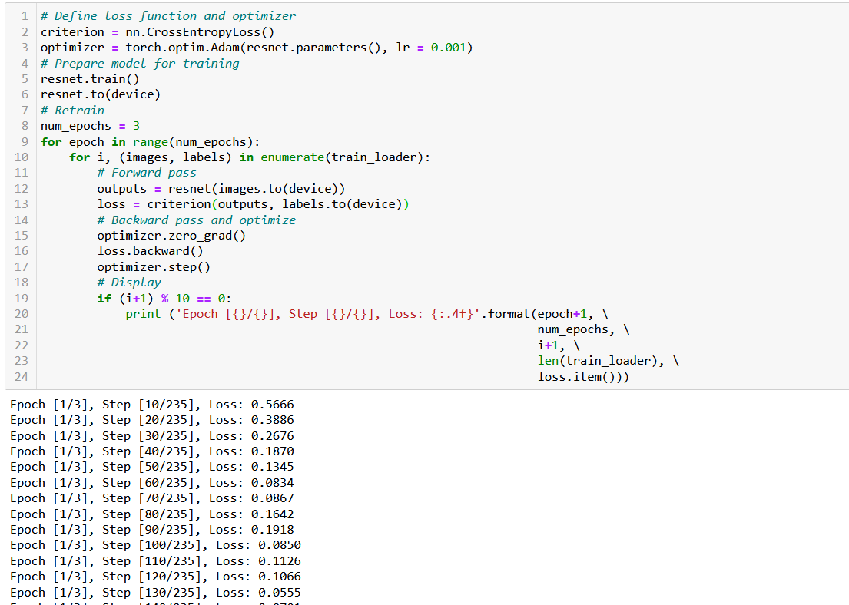
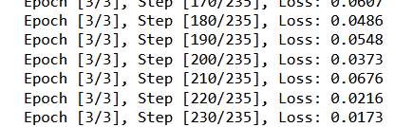
Wait that works?!
That feels borderline illegal!

Slide 57
Finetuning and unfreezing layers
Definition (fine-tuning and unfreezing layers):
Introduced in [Yosinski2014], fine-tuning, suggests to use a pre-trained network as a starting point, as before.
However, the network is further trained by progressively unfreezing some of its layers, therefore allowing the weights in those layers to be updated during re-training.
Usually, we will start by freezing all layers except the last few ones, and will progressively retrain layers, unfreezing more and more of them.
Doing so, the network can be adapted to the new problem and often achieve better performance.
(Works, but we leave it to students to try it out!)

Slide 58
Conclusion (Week 4)
Encoding images as matrices and tensors
The convolution operation, in full (kernel, padding, stride, dilation)
Image processing using convolutions
Building a convolutional layer and a Convolution Neural Network.
On the performance of Convolution vs. Linear
More operations on images (pooling, batchnorm, dropout)
Data augmentation
Some milestone models and their key ideas (residuals, parallelizing, dynamic scaling, etc.)
A ramp to 50.035 Computer Vision on Term 7!
Transfer learning and fine-tuning

Slide 59
Learn more about these topics
Out of class, supporting papers, for those of you who are curious.
[Krizhevsky2012] A. Krizhevsky, I. Sutskever, and G. Hinton, “ImageNet Classification with Deep Convolutional Neural Networks”, 2012.
[Simonyan2014] K. Simonyan and A. Zisserman “Very Deep Convolutional Networks for Large-Scale Image Recognition”, 2014.
[He2015] K. He, X. Zhang, S. Ren, and J. Sun “Deep Residual Learning for Image Recognition”, 2015.

Slide 60
Learn more about these topics
Out of class, supporting papers, for those of you who are curious.
[Huang2016] G. Huang, Z. Liu, L. van der Maaten, K. Q. Weinberger, “Densely Connected Convolutional Networks”, 2016.
[Szegedy2014] C. Szegedy et al., “Going deeper with convolutions”, 2014.
[Tan2019] M. Tan and Q. V. Le, “EfficientNet: Rethinking Model Scaling for Convolutional Neural Networks”, 2019.
[Yosinski2014] J. Yosinski et al., “How transferable are features in deep neural networks?” 2014.

Slide 61
Learn more about these topics
Tracking important names (Track their works and follow them on Scholar, Twitter, or whatever works for you!)
Karen Simonyan: Fromer researcher at Facebook AI, now Co-Founder and Chief Scientist at Inflection AI. https://scholar.google.com/citations?user=L7lMQkQAAAAJ&hl=fr https://www.robots.ox.ac.uk/~karen/
Andrew Zisserman: Professor at the University of Oxford and Principal Researcher at DeepMind. https://scholar.google.com/citations?user=UZ5wscMAAAAJ&hl=en https://www.robots.ox.ac.uk/~az/

Slide 62
Learn more about these topics
Tracking important names (Track their works and follow them on Scholar, Twitter, or whatever works for you!)
Shaoqing Ren: Working at NIO and University of Science and Technology in China (USTC). https://scholar.google.com.hk/citations?user=AUhj438AAAAJ&hl=zh-CN
Jian Sun: Worked as Microsoft, now Director of Research at MEGVII Technology. https://scholar.google.com/citations?user=ALVSZAYAAAAJ&hl=en http://www.jiansun.org/
Quov V. Le: Research Scientist at Google Brain. https://scholar.google.com/citations?user=vfT6-XIAAAAJ&hl=en

Slide 63
Learn more about these topics
Some extra (easy) reading and videos for those of you who are curious.
[VisualisingConv] A good article explaining Convolution on images with animated GIFs to visualise operations. https://towardsdatascience.com/intuitively-understanding-convolutions-for-deep-learning-1f6f42faee1
[ExplainConv] A good guide on how Convolution works, from Mathematics to images convolutions (will typically explain the reason for flipping kernels!) https://betterexplained.com/articles/intuitive-convolution/
[MIT2022] The CNN lecture at MIT (high-level, but should be ok now?) https://www.youtube.com/watch?v=uapdILWYTzE

